Slide 1
College Fee Checker
DOMAIN NAME : WEB TECHNOLOGY
TEAM MEMBERS :
Paulson J
Naveen C

Slide 2
Project Abstract
The College Fee Checker is a web-based application designed to simplify and automate the fee management process for educational institutions. This system allows students to securely access their fee details, including tuition fees, hostel fees, and other charges, through a user-friendly platform. By streamlining the verification and retrieval of fee-related information, the application enhances efficiency, accuracy, and transparency for both students and administrative staff.
The application utilizes a frontend built with HTML, CSS, and JavaScript for a responsive and visually appealing user experience, while the backend is powered by Node.js and Express.js, integrated with Microsoft SQL Server for secure data storage and management. Students authenticate using their unique Student Registration Number (SPR NO) and Date of Birth (DOB), ensuring secure access to their individual fee records. Once logged in, users can view a detailed breakdown of their fees, as well as the total amount payable.
By leveraging modern technologies and a scalable architecture, the College Fee Checker provides an efficient, reliable, and easy-to-use solution for managing and accessing student fee information. This project aims to reduce administrative workload, minimize errors, and improve the overall student experience in fee management processes.

Slide 3
Technologies Used
Frontend:
HTML5 & CSS3: Utilized for structuring and styling the web pages, ensuring a responsive and aesthetically pleasing user interface.
JavaScript: Implements interactive functionalities, enhancing user engagement and experience.
Google Fonts: Incorporated to provide modern and readable typography, contributing to a clean and professional design.
Backend:
Node.js & Express.js: Serve as the foundation for the server-side operations, handling requests, responses, and business logic efficiently.
Microsoft SQL Server: Employed as the relational database management system to store and manage student data and fee details securely.
MSSQL Package: Facilitates seamless communication between the Node.js server and the SQL Server database.
dotenv: Manages environment variables, ensuring sensitive information like database credentials remains secure.
Security & Performance:
CORS Middleware: Enables Cross-Origin Resource Sharing, allowing the frontend to communicate securely with the backend API.
Session Storage: Utilized for temporary data storage, enhancing security by ensuring session data is cleared upon browser closure.

Slide 4
Overview
The College Fee Checker is a web-based application designed to streamline fee management for educational institutions. It provides a secure platform for students to access detailed information about their fees, enhancing transparency and efficiency.

Slide 5
Features
Secure Authentication:
Students can log in using their unique Student Registration Number (SPR NO) and Date of Birth (DOB), ensuring that only authorized individuals access their fee information.
Comprehensive Fee Breakdown:
Upon successful authentication, students can view a detailed breakdown of their fees, including hostel fees, tuition fees, textbook fees, skill development fees, exam stationery fees, and notebook fees.
Responsive Design:
The application is designed to be fully responsive, providing an optimal viewing experience across various devices, including desktops, tablets, and smartphones.
User-Friendly Interface:
A clean and intuitive user interface ensures that students can navigate the application effortlessly, accessing the information they need without unnecessary complexity.
Error Handling:
Robust error handling mechanisms inform users of any issues during login or data retrieval, enhancing the reliability and trustworthiness of the application.

Slide 6
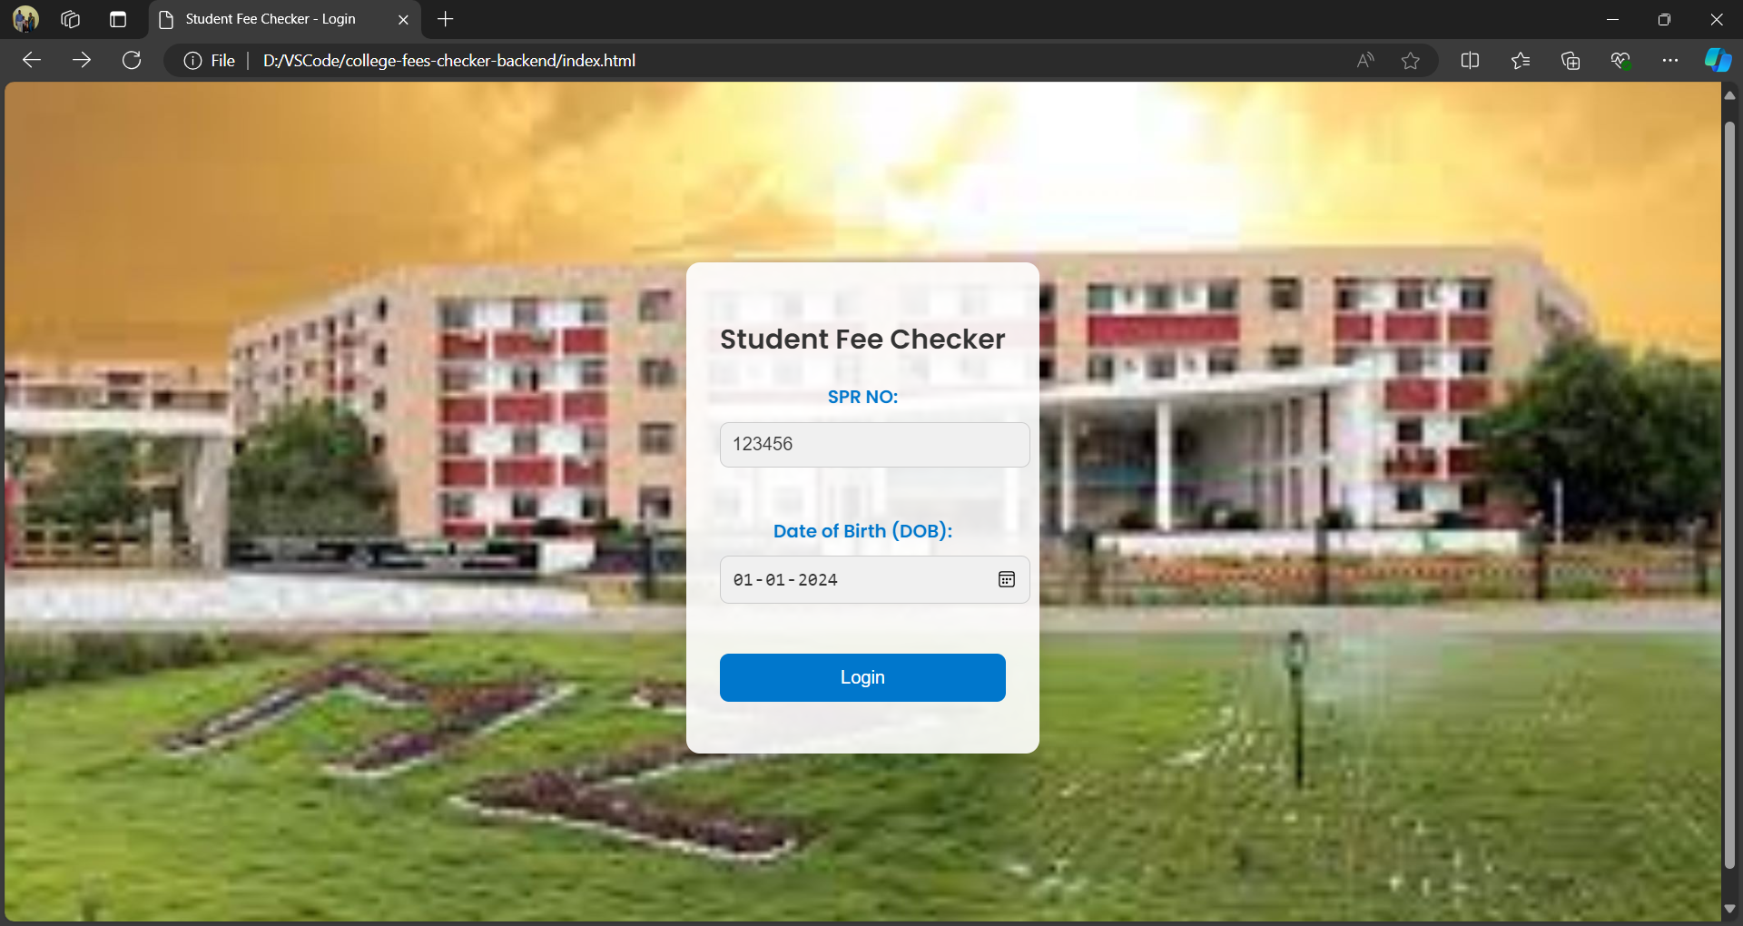
Output

Slide 7
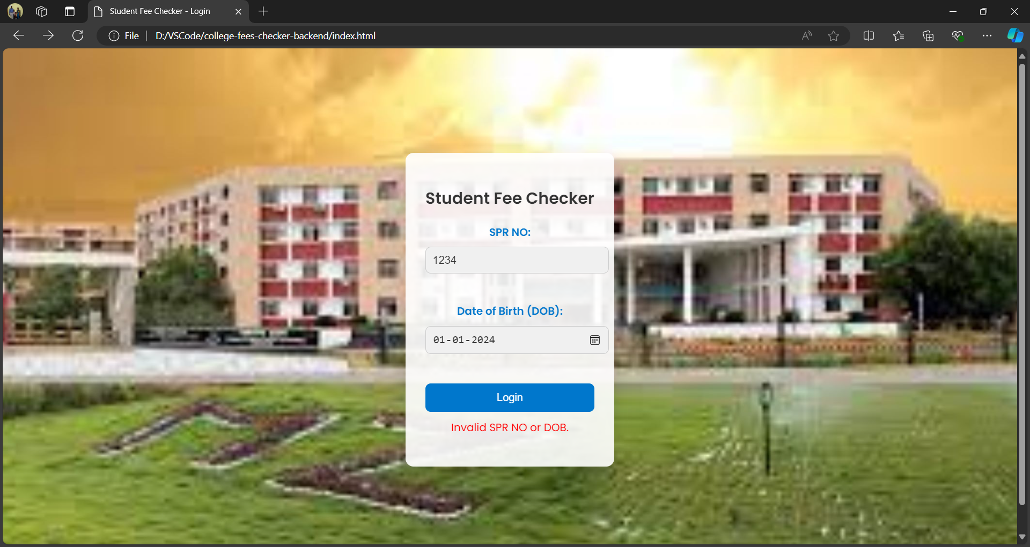

Slide 8
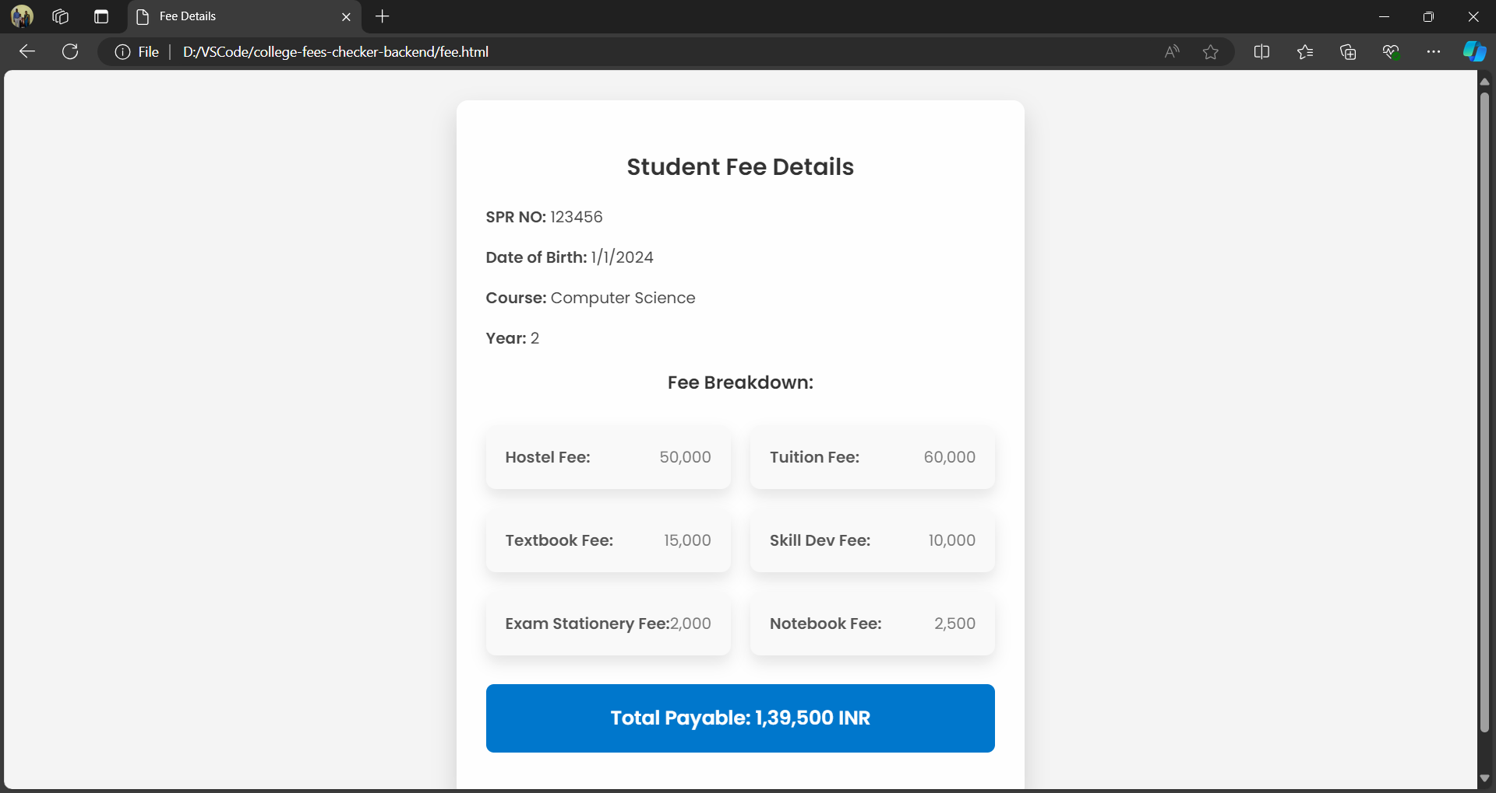

Slide 9
Conclusion
The College Fee Checker project embodies a modern solution to traditional fee management challenges faced by educational institutions. By leveraging cutting-edge web technologies and a robust backend infrastructure, the application delivers a secure, efficient, and user-friendly platform that significantly enhances the fee management experience for both students and administrators. As educational environments continue to evolve, tools like the College Fee Checker play a crucial role in fostering operational excellence and student satisfaction.

